Slide 1
Malaria KAP Baseline Study
Local and migrant communities in Phuket
Presented by:
Daniel Lindgren, Rapid Asia Co., Ltd.
28 February, 2011

Slide 2
Outline
Background & Methodology
Protection & Risk Exposure
Health Seeking Behavior
Media Access & Exposure
Issues for Communication

Slide 3
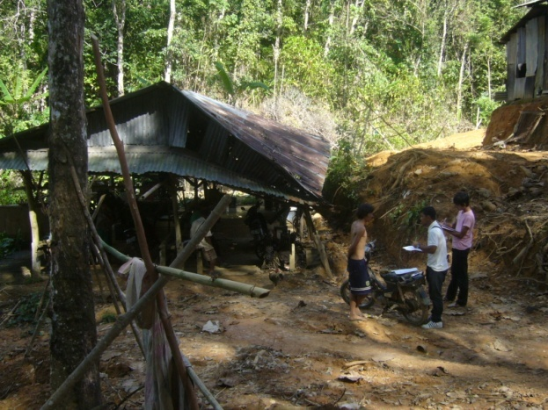
Background & Methodology

Slide 4
Methodology in Brief
Target groups
Local Thai communities monthly household income of around 15,000 Baht or less
Registered Burmese migrants
Unregistered Burmese migrants
Soft quotas for Burmese and Mon
Migrant Industries
Fishing
Construction
Rubber tapping
15 separate camp locations (Thai community selected nearby)
Sample size 800 (50/50 migrants and Thai)
All face to face interviews

Slide 5
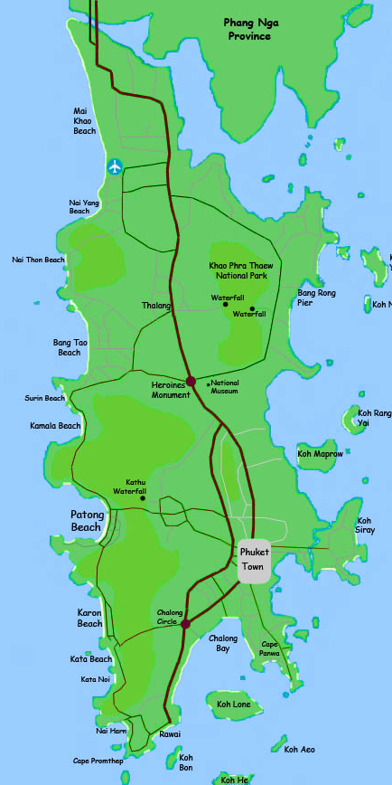
Migrant Camp Locations
9
No. | Camp
1 | Klong Pak Bang
2 | Koh Sirey
3 | Sapan Pramong / Sang Arun Pier
4 | Nara Project
5 | Nai Somsak
6 | Koh Kaew / Behind int’l school
7 | Karon Temple
8 | Pra Yai Temple
9 | Soi Mau Khoa
10 | Para
11 | Khao Pae Aw
12 | Khoa Bangkoo
13 | Bang Thao
14 | Nam Tok Ton Sai
15 | Luang Pu Supa Temple
4
10
14
11
13
12
6
1
2
3
7
8
15
5

Slide 6
Sampling and Sample Size
Random selection of households within the pre-selected migrant camps and Thai communities
Fieldwork from 11 October until 16 November
Quota sampling for good representation across industry and malaria transmission risk (input from Malaria Unit)
Malaria Transmission Risk | Migrant Rubber Tapping (n) | Migrant Fishing (n) | Migrant Construction (n) | Thai Community (n) | Total (n)
High | 39 | 10 | 100 | 200 | 349
Moderate | 50 | 45 | 50 | 100 | 245
Low | 11 | 45 | 50 | 100 | 206
Total | 100 | 100 | 200 | 400 | 800

Slide 7
Respondent Segments
Thai Origin
Migrant Origin
Migrant Status
Most of the Thais interviewed were local Thais who grew up in Phuket but some had moved in from other provinces. Migrants are split nearly 50/50 between Burmese and Mon. 74% of four migrants interviewed were registered.
Base: All respondents (Thai n=400, Migrants n=400)

Slide 8
Risk Profile Segmentation Summary
Risk Element | Thai | Registered Migrants | Unregistered Migrants
Demographic profile
Knowledge
Vector conditions
Risk Exposure
Protection: Malaria
Provide Blood Samples
Seeking appropriate care
Protecting children
Medicine
Treatment follow up
Media Access
Mobile phone Access
Exposure to health messages
Protection and Risk exposure
Health seeking behavior
Media access and exposure

Slide 9
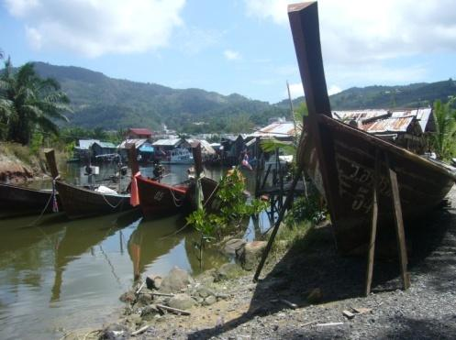
Protection & Risk Exposure

Slide 10
Day/Night Time Mosquitoes Association Proportion who get it right
Thai
Migrants
Dengue
Dengue
 | Wrong | Correct
Wrong | 20% | 34%
Correct | 1% | 45%
 | Wrong | Correct
Wrong | 18% | 18%
Correct | 16% | 48%
Malaria
Malaria
People are confused about whether Malaria and Dengue are associated with day or night time mosquitoes. The results show that less than half the Thai population (45%) and migrant population (48%) get both correct. Around one in five people in both populations get both wrong. A further one third will have one or the other incorrect.
Base: Those aware of dengue and malaria
(Thai n=398, Migrants n=311)

Slide 11
Use of Window Screens Observation
Thai
Migrants
Nearly half the Thai population do not use window screens but those who do will in most cases have them on all windows. Just about all migrants have no screen protection against mosquitoes unless they use a net.
Base: All respondents (Thai n=400, Migrants n=400)

Slide 12
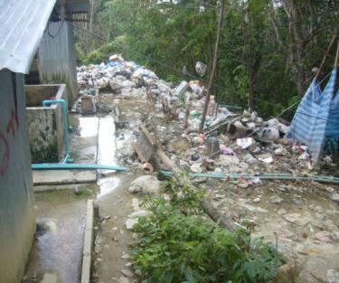
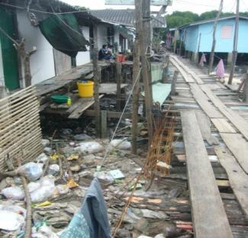
Littering of Water Collecting Containers Observation
Thai Households
Migrant Households
Migrant Camps
Base: All respondents (Thai n=400, Migrants n=400)

Slide 13
Mosquito Net, Repellent and Coil Observation
Observed in home
Fewer (77%) unregistered migrants have nets
Most migrants have mosquito nets and nine out of ten nets are in good condition with no holes in them. 62% also use mosquito coil but repellant is used to a lesser extent (29%). Fewer Thais use mosquito nets. It should be noted that using nets did not differentiate between those aware of malaria or not aware, suggesting some use nets just to avoid mosquitoes bites.
Base: All respondents (Thai n=400, Migrants n=400)

Slide 14
Preventative Practice for Malaria Thai
Extent of practice
Reason for NOT always using mosquito nets
80% of Thais don’t always use a net. The main reason for not using a net is that they don’t feel it is needed (82%). In some cases this is due to having their windows fitted with screens.
Base: All Thai respondents (n=400)
Base: Those not always using mosquito nets (n=319)

Slide 15
Preventative Practice for Malaria Migrants
Extent of practice
Reason for NOT always using mosquito nets
Fewer (74%) unregistered migrants always use a net
20% of migrants report not using a net. “Too hot” is the most common response (61%) for not using. 75% also report not using mosquito repellent.
Base: All Migrant respondents (n=400)
Base: Those not always using mosquito nets (n=80)

Slide 16
At Risk of Exposure to Malaria Vectors
Thai
Migrants
Taking into account the combination of either having screens on all windows or using mosquito nets, many Thais who don’t have window screens do use mosquito nets to a greater extent. However, many use neither and results in many Thais being at risk of exposing themselves to malaria vectors. Because Thai communities are in the vicinity of the migrant camps, the risk of exposure may be greater.
Base: All respondents (Thai n=400, Migrants n=400)

Slide 17
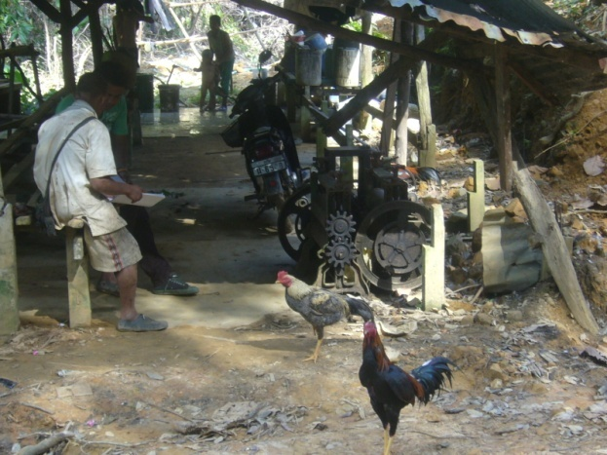
Health Seeking Behavior

Slide 18
Willing to Give a Blood Sample to a HCW Thai vs. Migrants
Thai
Migrants
The vast majority of both Thais and migrants are willing to participate in a blood test if asked by a HCW. Some Thais may hesitate and would only participate if they thought they were ill.
Base: All respondents (Thai n=400, Migrants n=400)

Slide 19
Who Would You Ask for Advice? Symptom: High fever and cold shivers
High fever and cold shivers were used as a hypothetical scenario to obtain information on health seeking behavior. The majority of both Thais and migrants would seek advice from a doctor should they come down with high fever and cold shivers. Migrants are also likely to seek advice from family and friends and may seek advice from their employer as well.
Base: All respondents (Thai n=400, Migrants n=400)

Slide 20
Where Would You Go For Treatment? Symptom: High fever and cold shivers
Reason for NOT going to hospital or clinic
 | Thai n=9* (%) | Migrants n=14* (%)
Language | 0 | 71
No Health Card | 0 | 29
Too expensive | 22 | 43
Don’t trust | 22 | 14
Too far away | 11 | 29
Can’t do better | 11 | 7
Waiting too long | 44 | 14
Other | 11 | 21
*Small base
The vast majority would seek treatment at a hospital or clinic. In Phuket there are plenty of small clinics and particularly unregistered migrants may seek treatment there if they can afford it. Government hospitals are cheaper and often preferred by migrants but the employer may have to bribe the police to enable transportation should the worker not be registered. Since two thirds of migrants can speak some Thai as well as English, language was not found to be a major barrier.
Base: All respondents (Thai n=400, Migrants n=400)
Base: Those not going to a hospital or clinic

Slide 21
Ever bought Medicine? Symptom: High fever and cold shivers
Type of medicine and location
Thai
 | Thai n=277 (%)
Type of medicine
Fever reducing | 99
Antibiotics | 11
Herbal | 1
Other | 0
Location
Pharmacy | 51
Local drug store | 48
Hospital / Clinic | 1
Other | 0
In response to high fever and cold shivers 69% of Thais have bought fever reducing medicine in the past (99%). Some also bought antibiotics (11%). They purchased the medicine at the pharmacy (51%) or a local drug store (48%).
Base: All Thai respondents (n=400)
Base: Those who bought medicine

Slide 22
Ever bought Medicine? Symptom: High fever and cold shivers
Type of medicine and location
Migrants
 | Migrants n=222 (%)
Type of medicine
Fever reducing | 97
Antibiotics | 11
Herbal | 6
Other | 1
Location
Pharmacy | 4
Local drug store | 92
Govn’t health centre | 4
Other | 0
56% of the migrants have purchased medicine for high fever and cold shivers. Fever reducing medicine is most common (97%). Migrants prefer to go to the local drug store (92%) as it is cheaper and usually closer at hand.
Base: All Migrant respondents (n=400)
Base: Those who bought medicine

Slide 23
Health Seeking Behavior After Treatment At hospital or clinic
If the hospital or clinic prescribe medicine, both Thais and migrants will take it as prescribed. Some Thais may stop taking the medicine should the symptoms disappear (19%). Both groups will go back for check up but some Thais (30%) may only do it if they are specifically told to do so by the doctor.
Base: Those who would seek treatment at a hospital or clinic
(Thai n=391 , Migrants n=386)

Slide 24
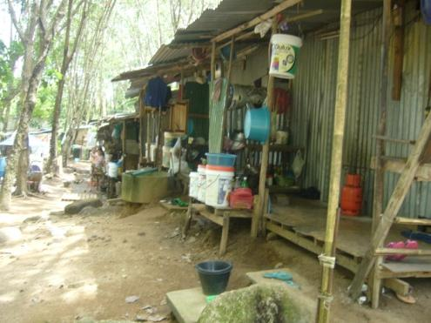
Media Access & Exposure

Slide 25
Media Penetration & Consumption
Media in household
Media consumed in past 7 days
Registered 65%
Unregistered 50%
Registered 31%
Unregistered 49%
Registered 34%
Unregistered 50%
36% of migrants (49% of unregistered migrants) don’t have access to any media. The only way to communicate to these migrants would be through HCWs, word of mouth or through their employer.
Base: All respondents (Thai n=400, Migrants n=400)

Slide 26
Mobile Phone Penetration
Thai
Migrants
53% for unregistered
Service Provider | n=372 (%)
AIS | 41
DTAC | 52
True Move | 7
Service Provider | n=244 (%)
AIS | 3
DTAC | 97
True Move | 0
Mobile phone penetration is very high amongst the Thai population (93%). Amongst migrants the penetration is lower (61%). Nearly all migrants use DTAC (97%). This is a result of DTAC’s promotional activities, offering reduced call rates between phones within the DTAC network.
Base: All respondents (Thai n=400, Migrants n=400)
Base: Those with mobile phones

Slide 27
Mobile Phone Features Used
Thai
Migrants
82% English*
14% Burmese
4% Thai
100% in Thai
Apart from making and receiving voice calls, Thais use SMS, Bluetooth and listen to the radio. The usage pattern for migrants is somewhat lower. 83% of migrants use roman characters when texting. This is due to font limitations on the phones. Only those who purchased their mobile phones from Burma or know how to download fonts can send SMS in Burmese. However, if they purchased the phone in Thailand the font may not be available.
Base: Those with mobile phones (Thai n=372, Migrants n=244)

Slide 28
Media Relied on For Health Information
Thai
Migrants
HCWs are relied upon by 69% of Thais and 49% of migrants. Whilst Thais rely on main stream media, migrants talk to their friends (61%). Employers represent a smaller but potentially significant source for migrants (17%).
Base: All respondents (Thai n=400, Migrants n=400)

Slide 29
Issues for Communication
Media Channel Selection
What media channels should be considered for Thai communities and migrants?
How can we take advantage of migrant employers and health care workers?
Mobile phone penetration is quite high amongst migrants and 97 percent use the same service provider (DTAC). Is this a potential opportunity?
Special effort is needed to reach out to unregistered migrants, how can this be achieved?
Messages Development
Thai communities are relatively well informed, yet they don’t always perceive the risks related to Malaria, and there is a lack of understanding in terms of how to protect against different vectors. What should be the focus for messaging?
How can vector reproduction be reduced more effectively, especially in camps that are littered with water collecting containers? What type of campaign could help to improve the situation?
Is there a need to resolve the confusion regarding day and night time mosquitoes?
Many migrants may not use nets when it is hot. They may use nets just to avoid being bitten and hence, if it is hot outside, the discomfort of itchy bits may be forsaken for a cool breeze while sleeping. How can the idea of using nets be repositioned?

